Slide 1


By Cem Alemdar and Jonathan Shiery

Slide 2
“Building onto one another”

Slide 3
Features
Game Mechanics
Build using previously placed beads
The beads stick to each other
Goal is to get from the start to the end
Different floor types that affect building
Game Progression
Hub world
Ability to finish levels in a nonlinear order

Slide 4
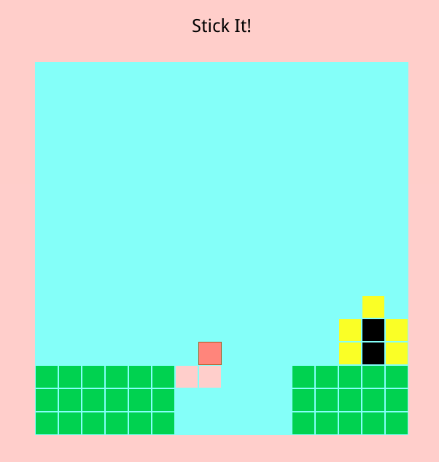
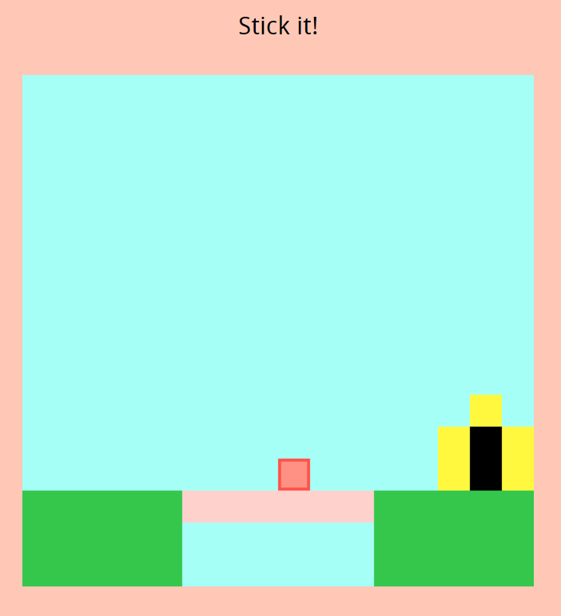
Screenshots
Before
After

Slide 5
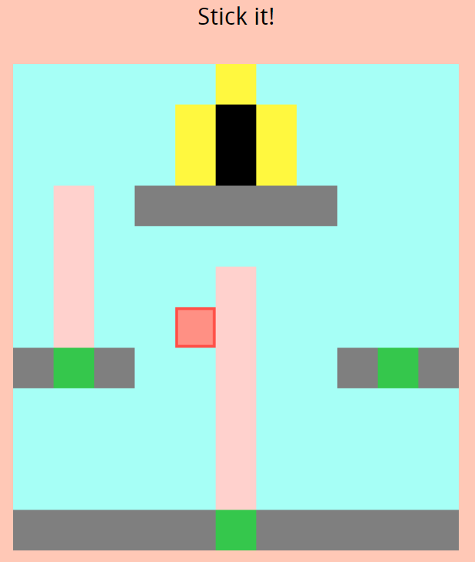
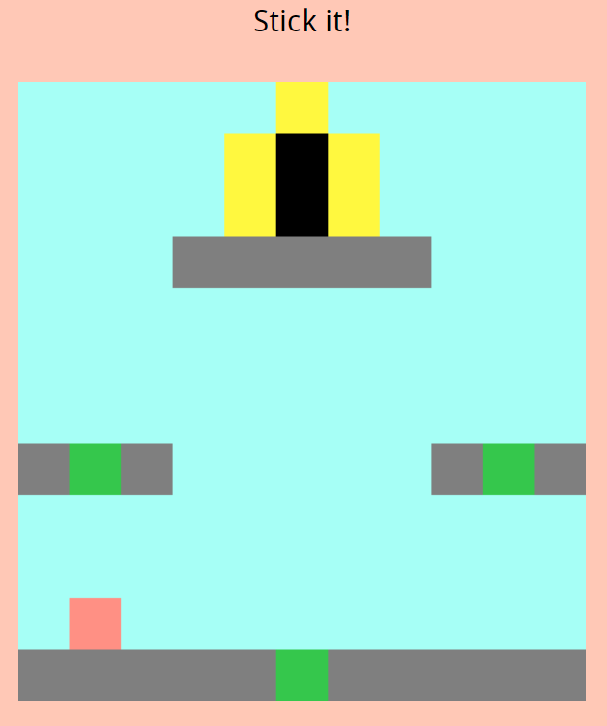
Screenshots
Before
After

Slide 6
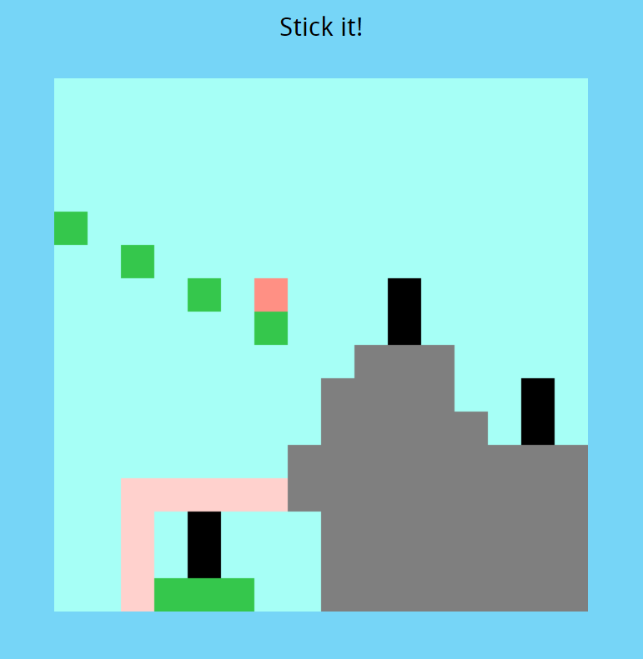
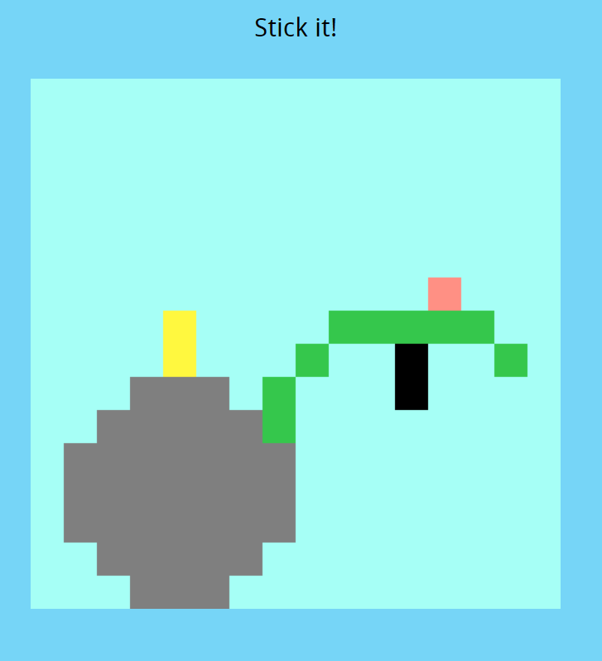
Screenshots

Slide 7

How is this wisdom?
Most of our wisdom consists of knowledge provided by previous knowledge. In this game, you progress by building on previous versions of yourself.

Slide 8
Restrictions
The grid cannot exceed 16 beads in either dimension at any time.
No glyphs are allowed in any beads.
Using only WASD and the space bar.

Slide 9
Playtests
The main goal of our playtests was to see how players would react to the pace of the game.
In our second playtest, we tested to see how players would react to a quicker block placement method.

Slide 10
Survey Feedback
Survey 1, Survey 2
Repetitive movement
Jumping and sticking mechanics required polish
More difficult levels
Improve the hub world

Slide 11
Critique
Game generally feels slow
More levels to explain the mechanics

Slide 12
Final Game Time

